Slide 1
Bike Store Management System
Course Name: Junior Design || Course Code: CSE 299 || Section: 07 || Group: 04
Git Repository: https://github.com/Nasim227/CSE299_Group-4.git
Group Members:
Md. Nasim Ahmed 2232936042
Md. Abir Hasan 2021833642
Md Murad Ul Momin 2232360642

Slide 2

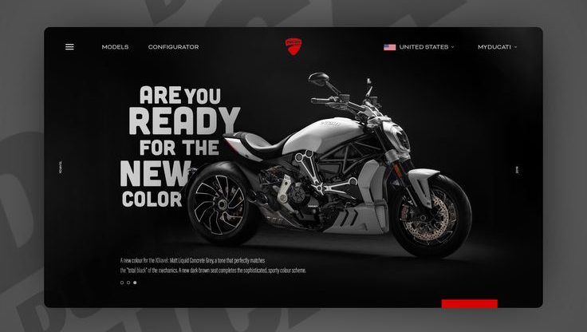

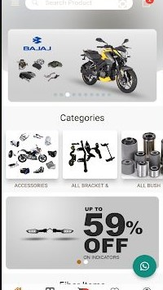
Bike Store Management System
The bike store management system is a web-based application for managing bike retail store activities. With this system delivery, we can automate everything from organizing the product, interacting with customers, sending stock alerts, generating invoices, and more. We are going to digitalize everything. The system will provide an enhanced UI/UX, data integrity, and easy access for customers and administrator users. The system can be used for better management of bike sales and inventory in an efficient manner while providing a high-quality experience to the customer without increasing the manual workload.

Slide 3

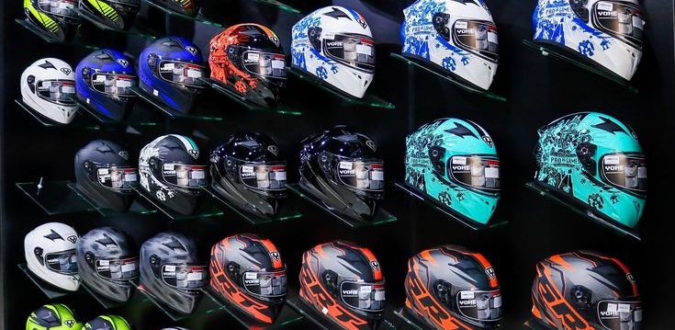
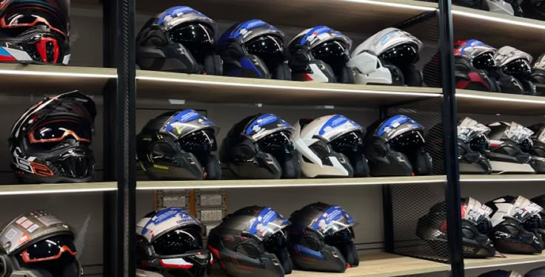
Project Overview
A web-based system to manage bike shop operations.
Automates product management, customer interaction, sales tracking, and report generation.
Aims to improve efficiency, reduce manual workload, and deliver better user experience.
Objectives
Create a dynamic and user-friendly bike shop website.
Build an efficient backend database system.
Enable modern features: bike view, product comparison, low stock alerts.
Integrate customer communication: email, WhatsApp.
Ensure accurate data through improved database architecture.

Slide 4
User Interface features:
Home page
Login and signup option
Navigation bar with multiple options
Dropdown menus to make user experience easy
Show products of different categories and brands
Search bar and Sidebar to filter result of shown product
See cart
Password change option for user
Discount and book products option for logged in users
Contact with customers through email (and contact_no)
Product compare option
Lot of brands and products for user to choose from
Classic design for each part of the website
Manager Interface features:
Home page
Login and signup option
Sidebar design for different task
Add, update, delete new products to the shop
Save information of the sold products
See product and user/customers information
Sold and booked products
See total monthly, yearly sell and keep track
See best selling product
Update/create discount for any product
Print invoice/create pdf

Slide 5



Technical Specifications
Frontend: HTML, CSS, JS, Bootstrap, Tailwind
Backend: PHP / Node.js / Java
Database: MySQL / PostgreSQL
IDE: Visual Studio Code

Slide 6



Expected Outcomes
Fully functional bike shop web system.
Admin/customer dashboards.
Real-time inventory and sales reports.
Enhanced user experience and performance.
Future Enhancements
Online payments (SSLCommerz, Bkash, Nagad).
Mobile app version.
AI-powered recommendations.
Chatbot and business analytics features.

Slide 7
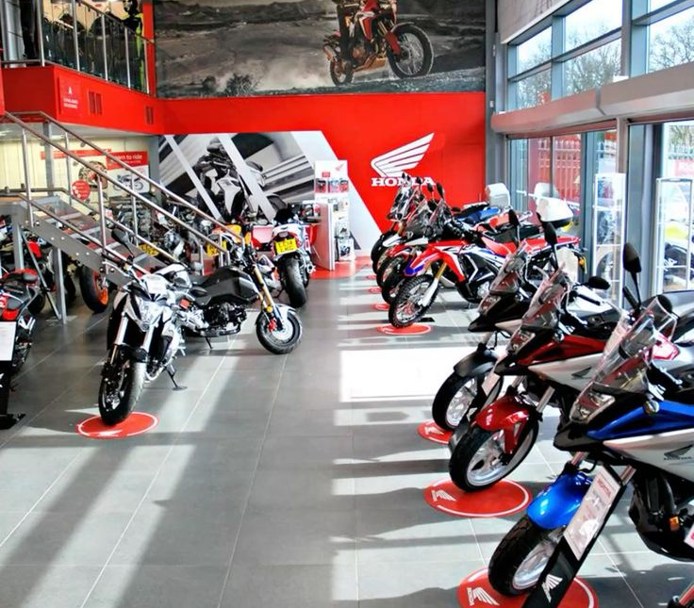
Conclusion
Our system transforms traditional bike stores into efficient, digital platforms.
Supports small businesses in Bangladesh with automation.
Scalable and adaptable for future technologies.

Slide 8
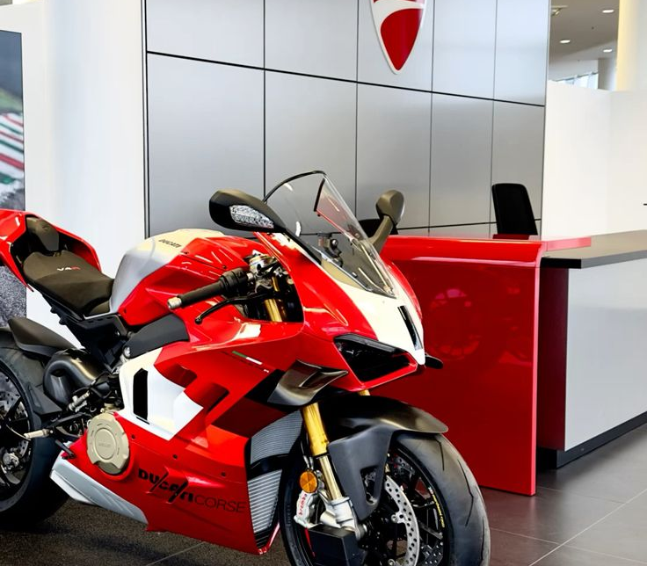
Thank you!
Any Questions?

